Slide 1
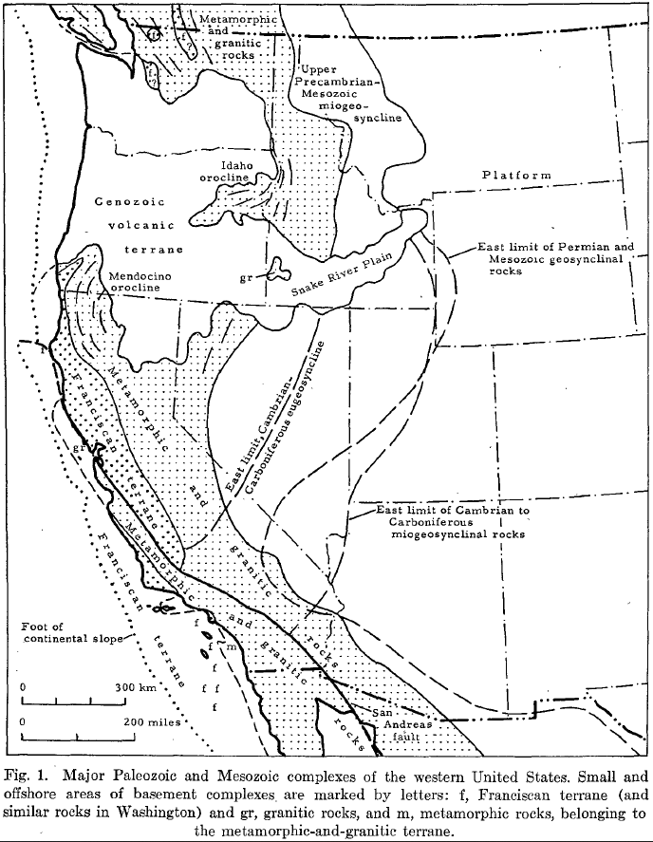
Cenozoic Tectonics of the Western united states
Hamilton & Myers 1966
Geol 730 Presentation By: Neal Mankins

Slide 2
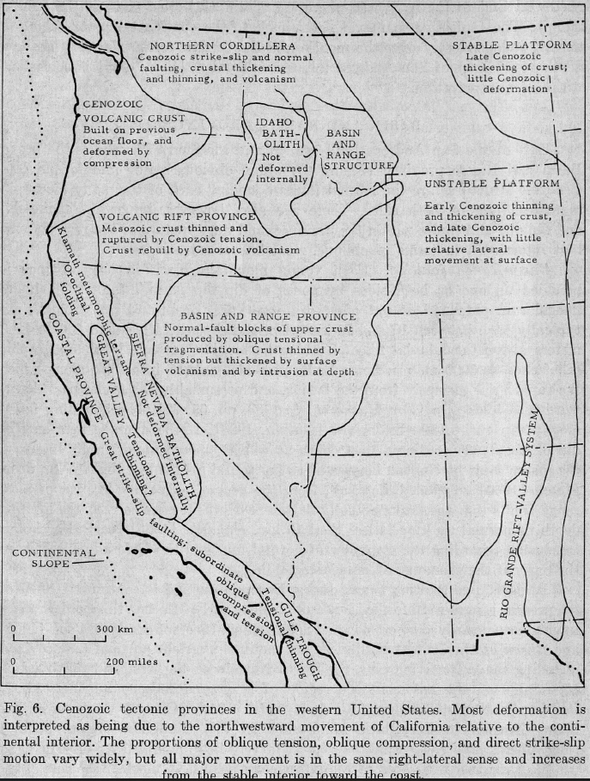
Purpose
Cite evidence for lateral motion in the western United States
(For our purpose) present style and timing of deformation
Method
Using previous research data to calculate wanted constraints
(No new data presented here)

Slide 3
Background 1
Basin & Range Province
Basin & Range blocks are typically 10-20km wide
Ranges are typically 500-1200m above basin alluvial fill
Basin & Range bounded by Sierra Nevada to the West & Wasatch to the East
Faulting began in Eocene

Slide 4
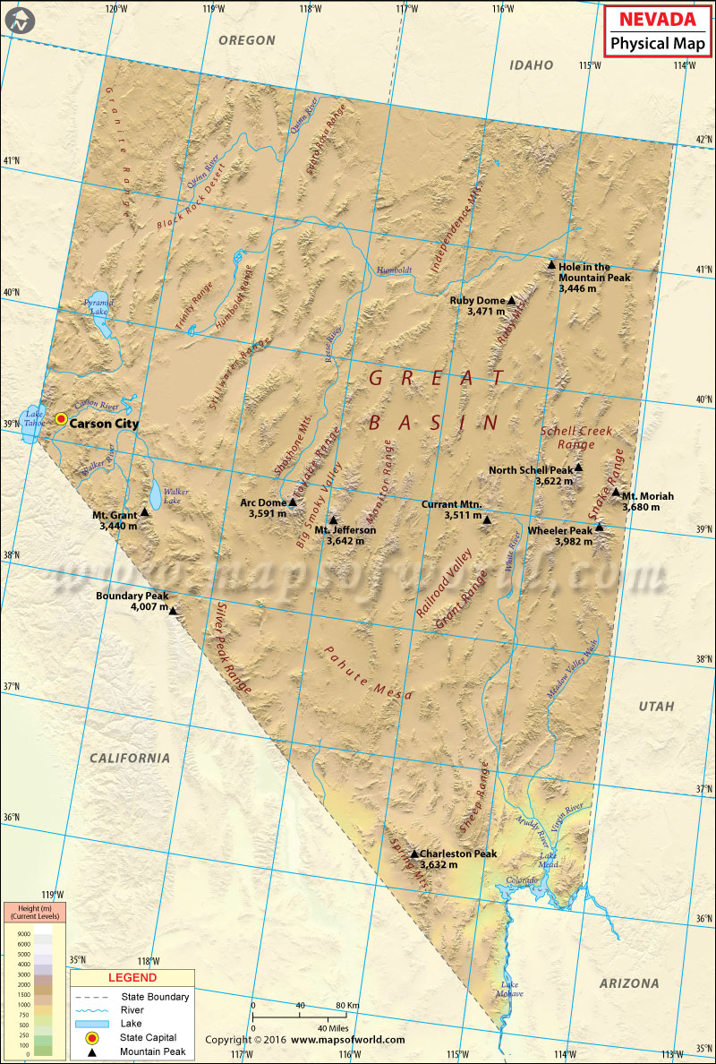
Background 11
Observations in relation to Latitude
~25 major range bounding faults in the basin & range province along the 40th parallel
North of the 35 parallel basins & ranges have equal areas but south of the parallel basins fill ~2x the area of bedrock ranges (where frontal scarps are not recognizable)
40°N
Strike-Slip faults
Right lateral strike slip faults trend NW between normal fault blocks in the Southwest portion of the Basin-Range province
Northeast of the strike-slip faults, basins-ranges trend N-NE in a tension-gash orientation
Greatest Pliocene & Quaternary faulting is on the Garlock fault (eastern California)
Normal Faults
Most dip ~40-80° basinward
35°N

Slide 5
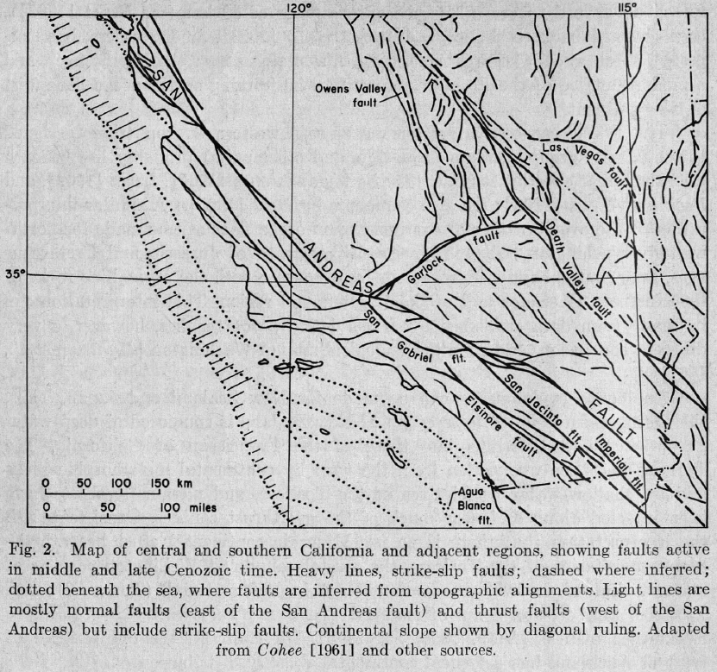
Death Valley Fault Zone
Funeral Range
Death Valley-Furnace Creek Fault
Using isopachs and facies features (Stewart, 1966) found that 80km of right lateral slip has offset formations between the Furnace Range & Panamint Range
Corrected (Wright & Troxel,1966) who found no significant offset in their isopach map
Panamint Range
Riverside Mtns.
Maria & Riverside Mtns.
Single faults in SE California have right lateral displacements of 2-15km (total 50km across zone)
Maria Mtns.

Slide 6
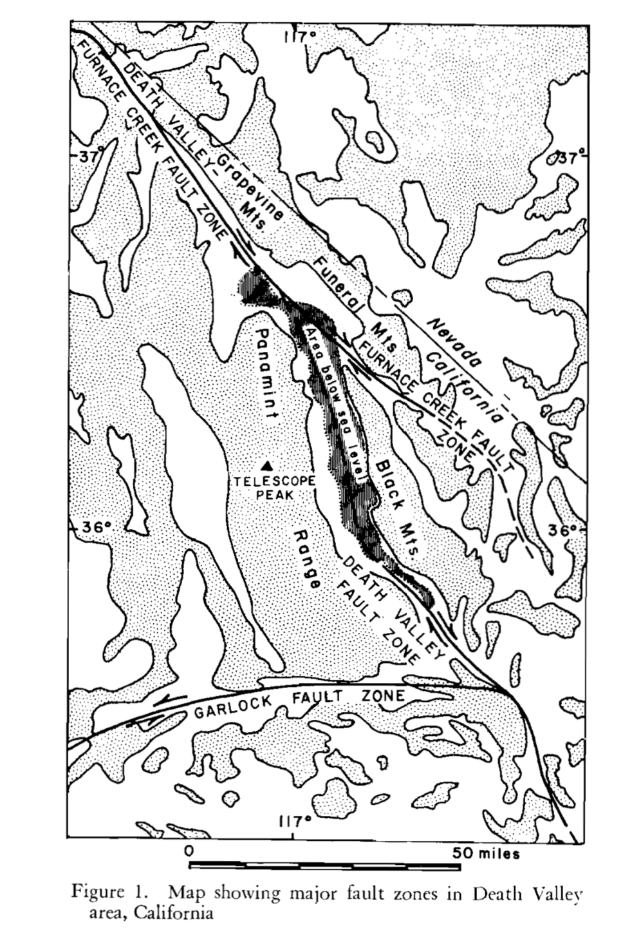
Death Valley Fault Zone
Funeral Range
Death Valley-Furnace Creek Fault
Using isopachs and facies features (Stewart, 1966) found that 80km of right lateral slip has offset formations between the Furnace Range & Panamint Range
Corrected (Wright & Troxel,1966) who found no significant offset in their isopach map
Panamint Range
Riverside Mtns.
Maria & Riverside Mtns.
Single faults in SE California have right lateral displacements of 2-15km (total 50km across zone)
Maria Mtns.
Burchfiel and Stewart., 1966

Slide 7
Las Vegas Fault
Right Lateral Strike-Slip
Trends Northwest
Isopachs of two Ordovician formations appear to be offset at least 40 km (Ross et al., 1964)
“Offset decreases to Northwest as deformation is taken up by “oroclinal drag”

Slide 8
Owens Valley Fault
Right Lateral Strike-Slip
Total Cenozoic strike-slip of ~25km (max) by correlating granitic pluton on the East (Inyo Mtns.) & West (Sierra Nevada) (Ross, 1962)

Slide 9
Garlock Fault
Left Lateral Strike-Slip
Left lateral movement indicated by offset dike swarms (Michael, 1966)
Total Cenozoic strike-slip of ~70km
If total height of major range-front scarps north of the Garlock fault is 7 or 8 km & the bedrock relief is twice the topographic relief, 15 km (max) of extension could have accompanied the formation of the present ranges
Left-lateral faults represent offsets between blocks deformed by drag within regional right-lateral northwest-trending shear system

Slide 10
Interpretation
Faulting
Range front faults flatten at depth, limiting depth of normal faulting <10km (assuming the general concavity of most range fronts (Moore, 1960))
“A fault dipping 60° requires I km of horizontal extension for each 2 km of dip-slip; if the faults do indeed ,flatten downward, the amount of extension needed approaches that of the dip-slip produced”
If we assign to each of these faults an average dip-slip displacement of 4 km, the crustal extension indicated by them is between 50 and 100 km
Assuming slip rates of the first half of the Cenozoic are similar to that in the later half then Total Cenozoic extension is within the range 100-300km

Slide 11
Findings
Death Valley Fault Zone
80km of right lateral slip
Las Vegas Fault Zone
40km of right lateral slip
Owens Valley Fault
40km of right lateral slip
Garlock Fault
70km of right lateral slip
Total Cenozoic extension in Northern Nevada & Utah ~300km
“This internal deformation may be superimposed on more extensive motion of North America as a whole, as there are grounds for arguing that the entire continent moved westward, and rotated slightly clockwise, as though about a pivot near the east coast, during at least the early part of Cenozoic time”

